Slide 1

OBJECTIVE
The object of the game is to become the wealthiest player through buying, renting, trading and selling of property.

Slide 2
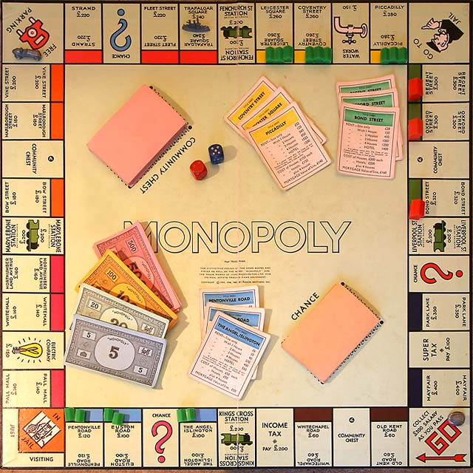
GAME SETUP
Game board
2 dice and player tokens
32 Houses and 12 Hotels
16 Chance and 16 Community Chest cards
22 Title Deed cards (1 for each property)
4 Teleport stations (only to and from each other)
2 Star spaces (where you get SME points)
Play money

Slide 3
The Play
Each player is given $1,500. Each player in turn throws the dice. The player with the highest total starts the play
After you have completed your play, the turn passes to the left. Two or more tokens may rest on the same space at the same time.
According to the space your token reaches, you may be entitled to buy properties - or obliged to pay rent, pay taxes, draw a card etc.
If you throw doubles, you move your token as usual, and are subject to any privileges or penalties pertaining to the space on which you land. Retaining the dice, throw again and move your token as before.
If you throw doubles three times in succession, you’re "In Jail”.

Slide 4

Go!
Each time a player's token lands on or passes over GO, whether by throwing the dice or drawing a card, the Bank pays a $200 salary.

Slide 5
BUYING PROPERTY
Whenever you land on an unowned property you may buy that property from the Bank at its printed price.
You receive the Title Deed card showing ownership.
If you do not wish to buy the property, the Bank sells it at auction to the highest bidder.
The buyer pays the Bank the amount of the bid in cash and receives the Title Deed card for that property. Any player, including the one who declined the option to buy it at the printed price, may bid.
Bidding may start at any price.

Slide 6
Mortgaging
The player receives money from the bank for each mortgaged property (half of the purchase price), which must be repaid with 10% interest to un-mortgage.
Houses and hotels can be sold back to the bank for half their purchase price.

Slide 7
The player receiving the mortgaged property must immediately un-mortgage it for the mortgage price plus 10%, or pay the bank just the 10% amount and keep the property mortgaged; if the player chooses the latter, they must still pay the 10% again if the property is later un-mortgaged.
Players cannot collect rent on mortgaged properties and may not give improved property (i.e. with houses/hotel) away to others; however, trading mortgaged properties is allowed.

Slide 8
Trading
As part of your turn, you can choose to trade properties and Get out of Jail cards in exchange of the same or cash with any player on board.
You can trade even if you are in jail.
Note: All developments on a monopoly must be sold before any property of that color can be mortgaged or traded.

Slide 9
Paying Rent
When you land on property owned by another player, the owner collects rent from you in accordance with the list printed on its Title Deed card.
If the property is mortgaged, no rent can be collected.

Slide 10

House rule on Free Parking
All the money from Luxury taxes, Jail money and other payments from Community Chest/Chance cards are collected at Free Parking spot.
The player who lands on this spot wins all money that’s collected on that spot.

Slide 11
Jail
You land in Jail when... (1) Your token lands on the space marked "Go to Jail", (2) You draw a card marked "Go to Jail" or (3) You throw doubles three times in succession.
When you are sent to Jail you cannot collect your $200 salary in that move since, regardless of where your token is on the board, you must move directly into Jail.
Your turn ends when you are sent to Jail. If you are not "sent to jail" but in the ordinary course of play lands on that space, you are "Just Visiting", you incur no penalty, and you move ahead in the usual manner on your next turn. You still are able to collect rent on your properties because you are "Just Visiting".

Slide 12
A player gets out of Jail by... (1) Throwing doubles on any of your next three turns, if you succeed in doing this you immediately move forward the number of spaces shown by your doubles throw. Even though you had thrown doubles, you do not take another turn. (2) Using the "Get Out of Jail Free Card" (3) Trading the "Get Out of Jail Free Card" from another player and playing it. (4) Paying a fine of $50 before you roll the dice on either of your next two turns. If you do not throw doubles by your third turn, you must pay the $50 fine. You then get out of Jail and immediately move forward the number of spaces shown by your throw. (5) Paying $20 (with increments of $10 in successive turns) to play a mini game to get out of jail. Even though you are in Jail, you may trade property on someone else’s call, sell houses and hotels and collect rents.

Slide 13
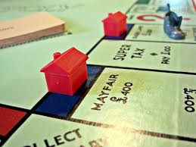
Houses and hotels
When a player owns all the properties in a colour-group, the owner charges double rent for unimproved properties in that colour-group. They may buy houses from the Bank and erect them on those properties. You cannot erect more than one house on any one property of any colour-group until you have built one house on every property of that group.
After building 4 houses on each property of the set, the player can further build. The next level is a hotel instead of the 4 houses.

Slide 14
Chance and community chest
Chance cards and Community Chest cards are special cards used in Monopoly. The player draws one of these cards when the player's token lands on one of the respectively named spaces on the Monopoly board and must follow its instructions. For most of either type of card after the directions are followed it is put back on the bottom of the deck.
If you are lucky, you will receive a scratch lottery card or you will be directed to a mini-game to receive bonuses!

Slide 15
New addition to game: Teleport Stations
New addition to game: Teleport
The classic railroads are ‘Teleport Stations’ in this game. These are not for purchase. Landing on these spaces can give the player a chance to ‘teleport’ across the board, i.e. move the token from one station to another on the board.
Note: The player may choose to stay at the same space and not travel. Choose wisely while teleporting!

Slide 16
New addition to game: SME points
On landing on Star Spaces, you earn a Super Mumbo Epic point. This allows you to trade some of these points to do the following during the course of the game:
3 points - Increase 10% rents on all owned properties for the next 5 turns
3 points - Pay 10% less rent for the next 5 turns
5 points - Hotel to gold hotel – 20% rent increase (permanent effect)
Exchange points for money – 1 SME is $100.

Slide 17
Custom mini games
Search! – In this mini game, the user has to search for required objects in limited amount of turns.
1. Jail version - In this version, the user has to search for 3 parts of a key in 6 turns in a 5*5 grid.
2. Chance/Community chest version – In this version of the game, the user has to find upto 3 coins in 5 turns in a 4*4 grid.
The coin game – In this mini-game, the user has to collect falling coins in 30 seconds. The user controls the tray with arrow keys. If in jail game, the user has to collect a minimum of 60 coins to get out of jail. There are also bonus blue coins worth thrice a coin. The user earns cash worth twice the number of coins earned.

Slide 18
End of game
The game ends when:
A player owns 3 color sets of properties
A player has a net worth of $5000.
Everybody but one is bankrupt
Now that you know how to play, let’s begin!

